Slide 1

 |  |  |  |  |  |  |  | EC Training
 |  |  |  |  | Document |  |  |  |  | SQL
 |  |  |  |  | Version |  |  |  |  | 1.0
 |  |  |  |  | Created Date |  |  |  |  | 15-02-2023

Slide 2
II | RECORD OF CHANGE
No | Created Date | Version | Change Description | Reason | Reviewer | Approver
1 | 19-02-2023 | 1.0 | Tạo mới | Nhằm nâng cao chất lượng giảng dạy tại EC, và đảm bảo tính thống nhất và quy định của Sổ tay thương hiệu mới của FPT Software | ToiDV
*Note: This 2 page only record doc information, not use

Slide 3
SQL Training
FWA.EC

Slide 4


s
1
1
Review
2
Exam
CONTENT
3
Exercise
4
Optimize
© Copyright FPT Software – Level of Confidentiality

Slide 5
01. Review

Slide 6
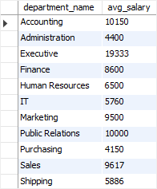
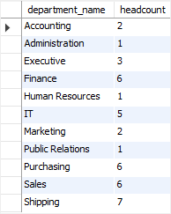
Aggregate Function
Performs a calculation on a set of values, and returns a single value.
Often used with the GROUP BY clause of the SELECT statement (Except for COUNT(*)).
SELECT department_name, ROUND(AVG(salary), 0) avg_salary
FROM employees
INNER JOIN departments USING (department_id)
GROUP BY department_name ORDER BY department_name;
SELECT department_name, COUNT(*) headcount
FROM employees
INNER JOIN departments USING (department_id)
GROUP BY department_name ORDER BY department_name;

Slide 7
Aggregate Function
You can use aggregate functions as expressions only in the following:
The select list of a SELECT statement, either a subquery or an outer query.
A HAVING clause
SELECT column1, column2, AGGREGATE_FUNCTION (column3)
FROM table1 GROUP BY column1, column2
HAVING group_condition;
HAVING vs. WHERE
The WHERE clause applies the condition to individual rows before the rows are summarized into groups by the GROUP BY clause. However, the HAVING clause applies the condition to the groups after the rows are grouped into groups.
Therefore, it is important to note that the HAVING clause is applied after whereas the WHERE clause is applied before the GROUP BY clause.

Slide 8
Multi table query
Join
Equi-join
Natural Join
A relational operation that causes two or more tables with a common domain to be combined into a single table or view.
A join in which the joining condition is based on equality between values in the common columns; common columns appear redundantly in the result table
An equi-join in which one of the duplicate columns is eliminated in the result table
Outer Join
Union Join
Self join
A join in which rows that do not have matching values in common columns are nonetheless included in the result table (as opposed to inner join, in which rows must have matching values in order to appear in the result table)
Includes all columns from each table in the join, and an instance for each row of each table
Matching rows of a table with other rows from the same table

Slide 9
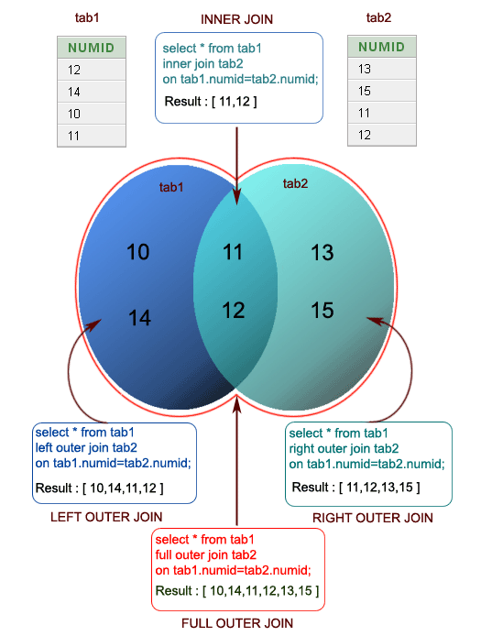
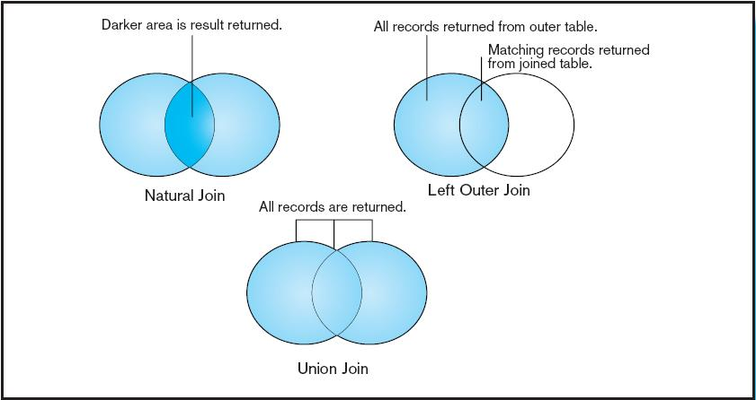
Multi table query

Slide 10
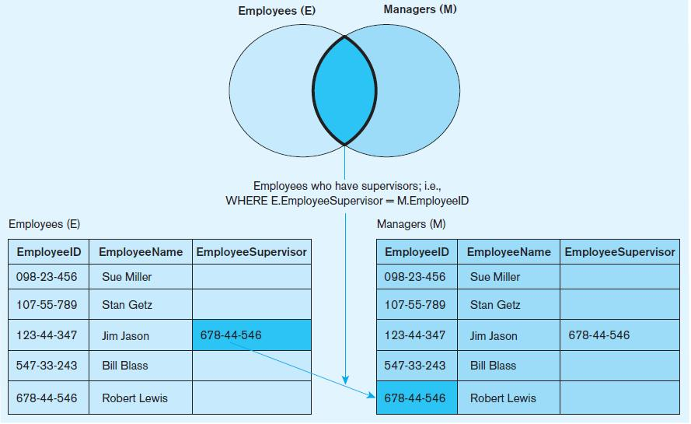
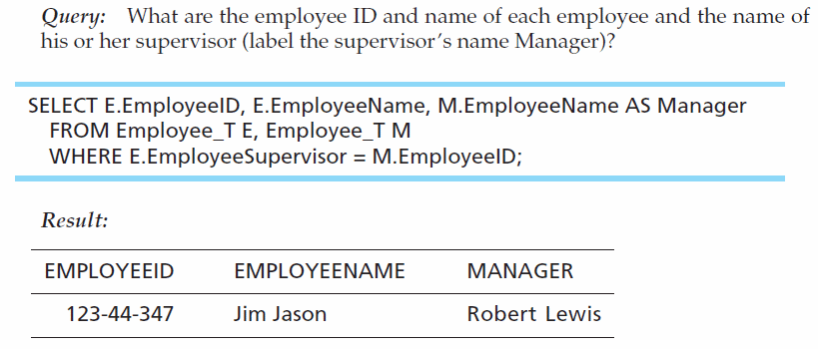
Multi table query

Slide 11
Multi table using subquery
A subquery is a query within another query. The outer query is called as main query and inner query is called as subquery.
The subquery generally executes first when the subquery doesn’t have any co-relation with the main query, when there is a co-relation the parser takes the decision on the fly on which query to execute on precedence and uses the output of the subquery accordingly.
SELECT column_name
FROM table_name
WHERE column_name expression operator ( SELECT COLUMN_NAME from TABLE_NAME WHERE ... );

Slide 12
PIVOT
Use the PIVOT and UNPIVOT relational operators to change a table-valued expression into another table.
PIVOT rotates a table-valued expression by turning the unique values from one column in the expression into multiple columns in the output.
SELECT <non-pivoted column>,
[first pivoted column] AS <column name>,
[second pivoted column] AS <column name>,
...
[last pivoted column] AS <column name>
FROM
(<SELECT query that produces the data>)
AS <alias for the source query>
PIVOT
(
<aggregation function>(<column being aggregated>)
FOR
[<column that contains the values that will become column headers>]
IN ( [first pivoted column], [second pivoted column],
... [last pivoted column])
) AS <alias for the pivot table>
<optional ORDER BY clause>;

Slide 13
02. Exam

Slide 14
DB Module
https://dataedo.com/samples/html/Data_warehouse/doc/AdventureWorksDW_4/home.html
Dimensions
Finance
Call Center
Inventory
Internet Sales
Sales Quotas
Surveys
Currency Rates
Reseller Sales
Product Descriptions

Slide 15
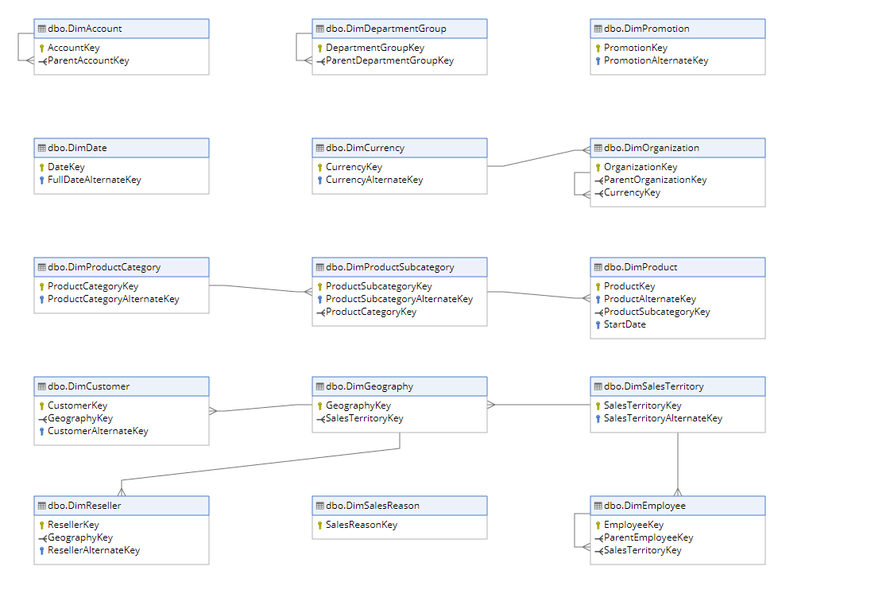
Dimensions
Dimensions

Slide 16
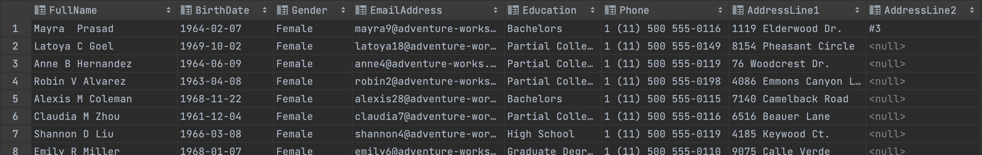
Dimensions Exercise
1. Get information about United Kingdom customers with Country Region Code of GB including columns: FullName, BirthDate, Gender, EmailAddress, Education (English), Phone, AddressLine1, AddressLine2
Note: FullName combines from FirstName, MiddleName, LastName Gender includes F and M, if F shows as Female, M shows as Male
Content: CONCAT(), ALIAS, Trinitarian operator, Join, Where

Slide 17
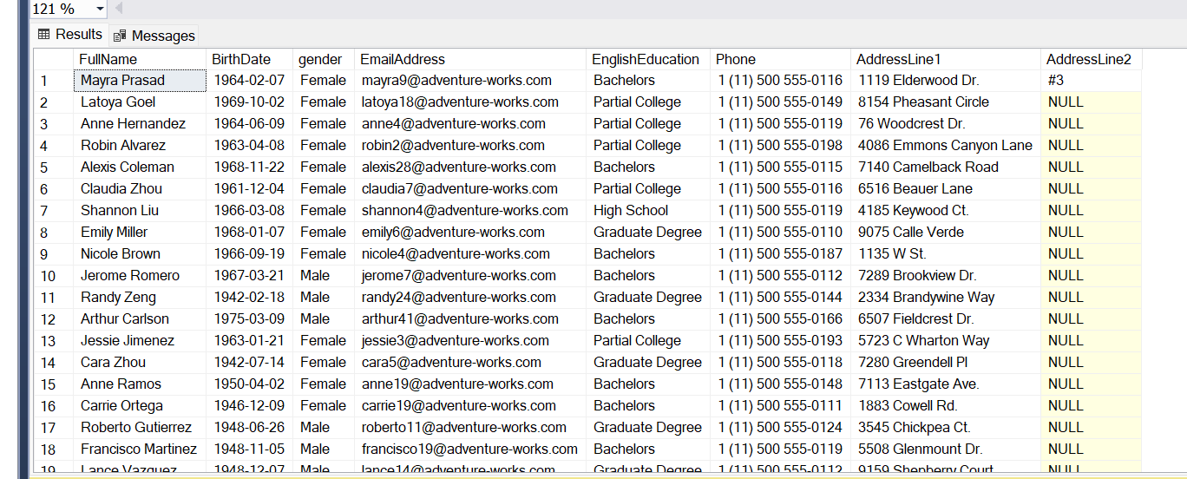
1. ANSWER
select
FullName=[DimCustomer].FirstName+ ' '+ [DimCustomer].LastName,
BirthDate,
case
WHEN DimCustomer.gender='F'
then 'Female'
when DimCustomer.gender='M'
then 'Male'
end
as 'gender',
EmailAddress,
EnglishEducation,
Phone,
AddressLine1,
AddressLine2
from DimCustomer
join DimGeography ON DimCustomer.GeographyKey=DimGeography.GeographyKey
where DimGeography.CountryRegionCode = 'GB';

Slide 18
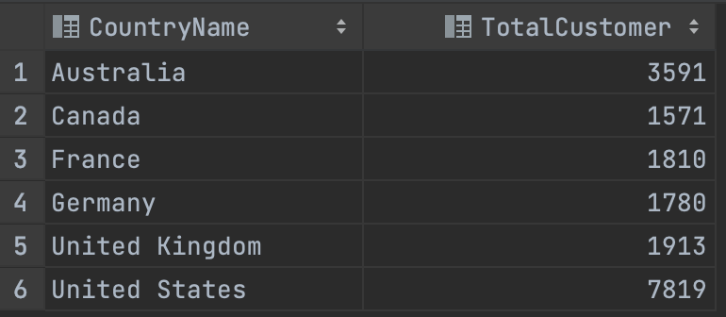
Dimensions Exercise
2. Total number of customers by country includes 2 columns: CountryName, TotalCustomer
Content: Aggregate Function, Group By

Slide 19
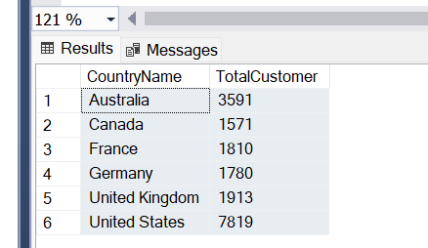
2.ANSWER
select DimGeography.EnglishCountryRegionName as CountryName, count(DimCustomer.CustomerKey) as TotalCustomer from DimCustomer
join DimGeography ON DimCustomer.GeographyKey=DimGeography.GeographyKey group by EnglishCountryRegionName ;

Slide 20
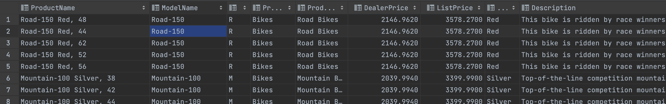
Dimensions Exercise
3. Get the top 100 products of the highest selling price (ListPrice) including the following columns:
ProductName (English), ModelName, ProductLine, ProductCategoryName (English), ProductSubcategoryName (English), DealerPrice, ListPrice, Color, Description (English)
Content: Top, Order By, Join Optimize

Slide 21
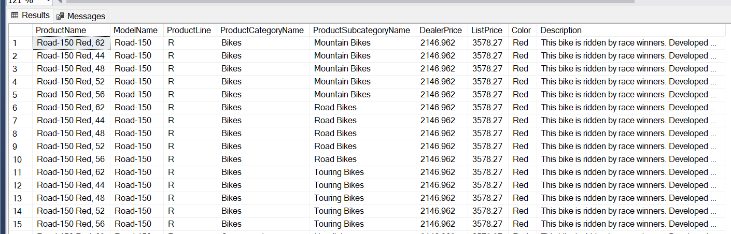
3.ANSWER
select top(100) DimProduct.EnglishProductName as ProductName,DimProduct.ModelName,ProductLine,DimProductCategory.EnglishProductCategoryName as ProductCategoryName,
DimProductSubcategory.EnglishProductSubcategoryName as ProductSubcategoryName ,DealerPrice,ListPrice,Color, EnglishDescription as Description
from DimProduct
join DimProductCategory on DimProductCategory.ProductCategoryAlternateKey=DimProductCategory.ProductCategoryKey
join DimProductSubcategory on DimProductCategory.ProductCategoryKey=DimProductSubcategory.ProductCategoryKey
order by ListPrice DESC;

Slide 22
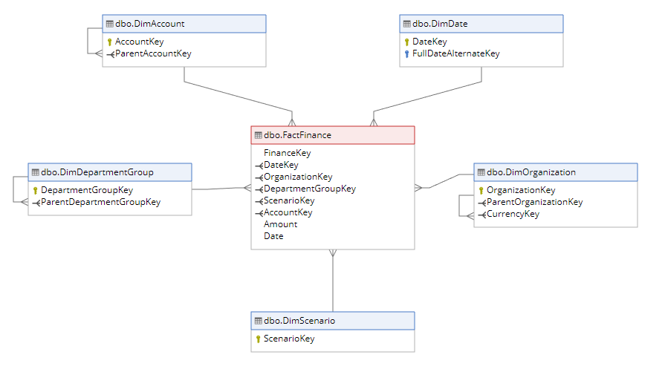
Finance
Finance

Slide 23
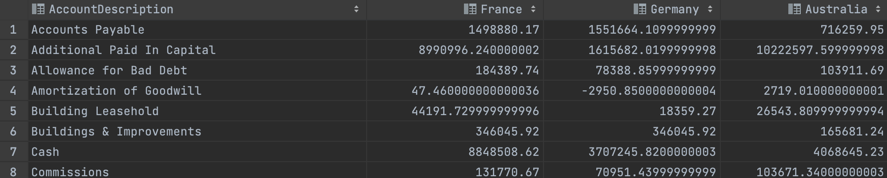
Finance Exercise
4. Based on the financial table (FactFinace), calculate the total amount of transactions according to each specific type of accounting compared between the three regions France, Germany, Australia, including the following columns: AccountDescription, France, Germany, Australia
For example, with an account called Accounts Payable, the sum of France is 1498880.17, Germany is 1551664.11, Australia is 716259.95
Note: arrange in A-Z order of AccountDescription
Content: Order By, PIVOT, For, Aggregate Function

Slide 24
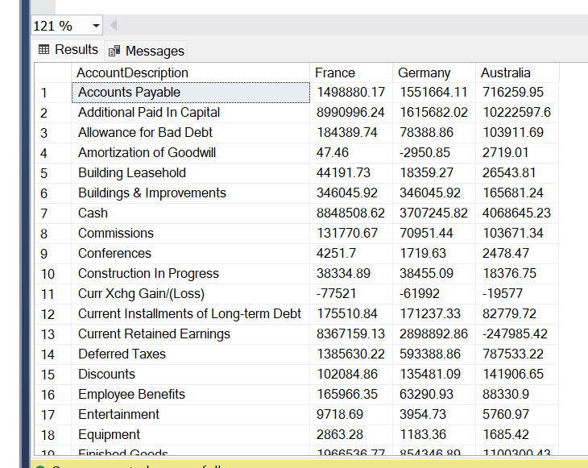
4.ANSWER
JOIN FactFinance
ON FactFinance.OrganizationKey = DimOrganization.OrganizationKey
JOIN DimAccount
ON DimAccount.AccountKey=FactFinance.AccountKey
) t
PIVOT(
SUM(amount)
FOR OrganizationName
IN (
[France],[Germany],[Australia])
) AS pivot_table;

Slide 25
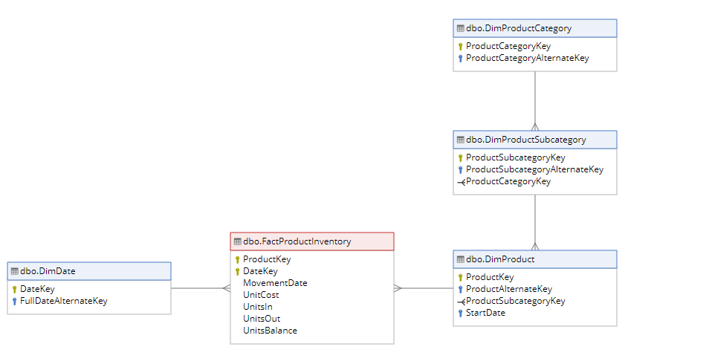
Inventory
Inventory

Slide 26
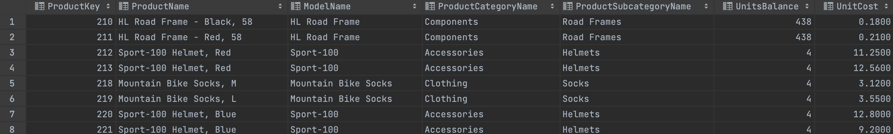
Inventory Exercise
5. Get the latest stock information of all products including the following columns:
ProductKey, ProductName (English), ModelName, ProductCategoryName, ProductSubcategoryName, UnitsBalance, UnitCost
Content: SubQuerys, JOIN condition

Slide 27
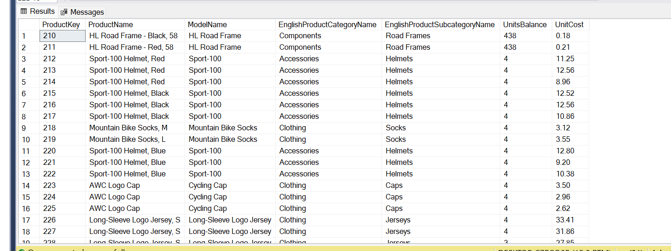
5.ANSWER
WITH group_data as(
select FactProductInventory.ProductKey, DimProduct.EnglishProductName as ProductName, DimProduct.ModelName,DimProductCategory.EnglishProductCategoryName,
DimProductSubcategory.EnglishProductSubcategoryName, FactProductInventory.UnitsBalance, FactProductInventory.UnitCost,
DimDate.CalendarYear , DimDate. DayNumberOfYear, FullDateAlternateKey,MovementDate,
ROW_NUMBER() OVER(PARTITION BY FactProductInventory.ProductKey ORDER BY MovementDate desc, FullDateAlternateKey desc) AS row_number
from FactProductInventory
join DimDate on FactProductInventory.DateKey=DimDate.DateKey
join DimProduct on DimProduct.ProductKey=FactProductInventory.ProductKey
join DimProductSubcategory on DimProduct.ProductSubcategoryKey=DimProductSubcategory.ProductSubcategoryKey
join DimProductCategory on DimProductCategory.ProductCategoryKey =DimProductSubcategory.ProductCategoryKey
)
SELECT
ProductKey, ProductName, ModelName,EnglishProductCategoryName, EnglishProductSubcategoryName, UnitsBalance,UnitCost
FROM group_data
WHERE row_number = 1
order by ProductKey;
;

Slide 28
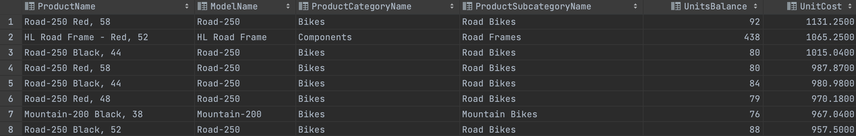
Inventory Exercise
6. Let's get the inventory information of the 10 products with the highest inventory value including the following columns:
ProductName (English), ModelName, ProductCategoryName, ProductSubcategoryName, UnitsBalance, UnitCost
Content: SubQuerys, JOIN condition, Aggregate Function

Slide 29
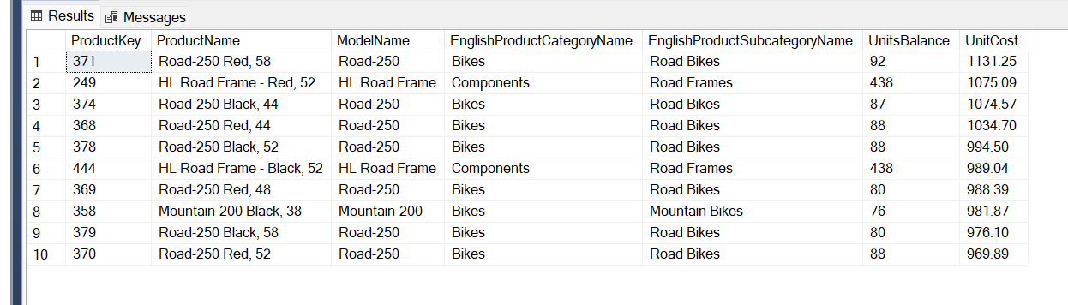
6.ANSWER
WITH group_data as(
select distinct FactProductInventory.ProductKey, DimProduct.EnglishProductName as ProductName, DimProduct.ModelName,DimProductCategory.EnglishProductCategoryName,
DimProductSubcategory.EnglishProductSubcategoryName, FactProductInventory.UnitsBalance, FactProductInventory.UnitCost,
DimDate.CalendarYear , DimDate. DayNumberOfYear, FullDateAlternateKey,MovementDate,
ROW_NUMBER() OVER(PARTITION BY DimProduct.EnglishProductName ORDER BY UnitCost desc, MovementDate desc) AS row_number
from FactProductInventory
join DimDate on FactProductInventory.DateKey=DimDate.DateKey
join DimProduct on DimProduct.ProductKey=FactProductInventory.ProductKey
join DimProductSubcategory on DimProduct.ProductSubcategoryKey=DimProductSubcategory.ProductSubcategoryKey
join DimProductCategory on DimProductCategory.ProductCategoryKey =DimProductSubcategory.ProductCategoryKey
)
SELECT distinct Top 10
ProductKey, ProductName, ModelName,EnglishProductCategoryName, EnglishProductSubcategoryName, UnitsBalance,UnitCost
FROM group_data
WHERE row_number =1
order by UnitCost desc
;

Slide 30
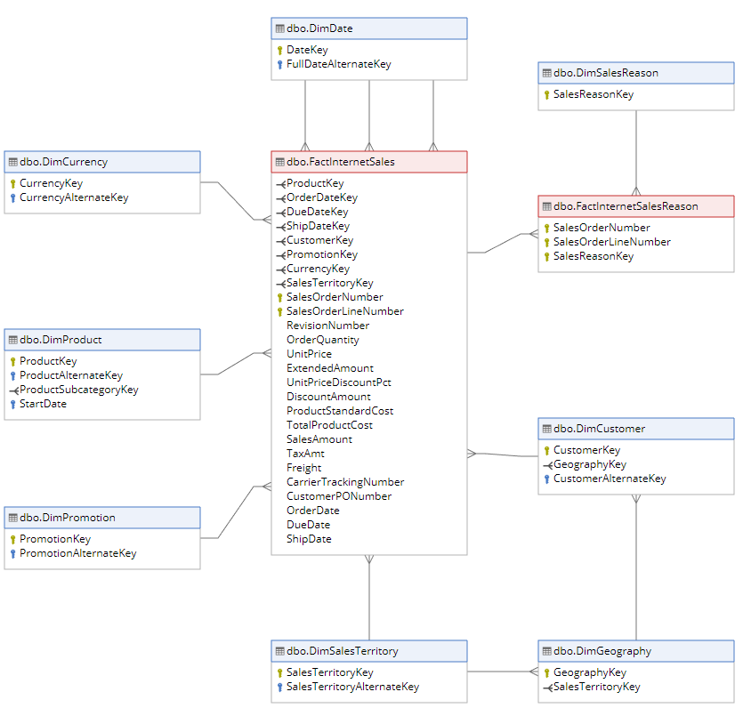
Internet Sales
Internet Sales

Slide 31
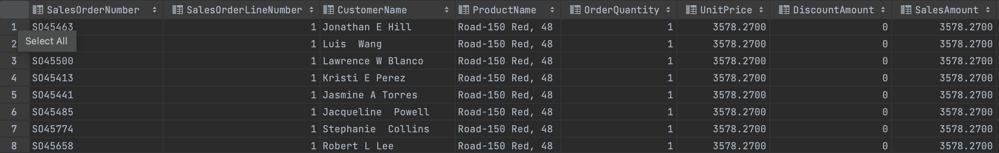
Inventory Exercise
8. Get the Internet Sales invoice details of the product whose English Name is "Road-150 Red, 48" including the following columns:
SalesOrderNumber, SalesOrderLineNumber, CustomerName, ProductName, OrderQuantity, UnitPrice, DiscountAmount, SalesAmount, ProductStandardCost, TotalProductCost

Slide 32
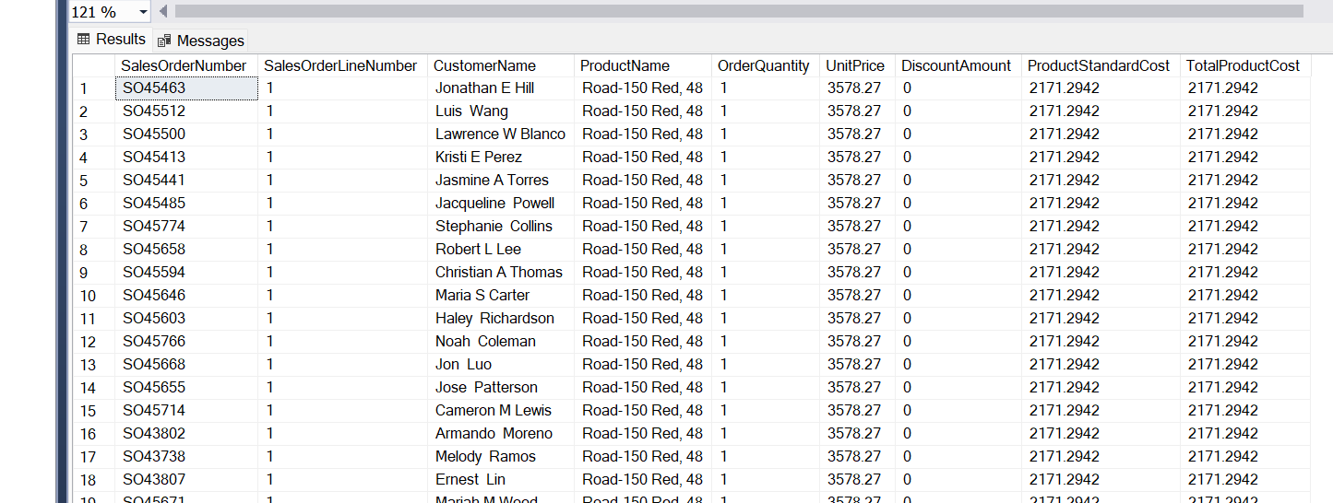
8.ANSWER
select SalesOrderNumber, SalesOrderLineNumber,CONCAT(FirstName,' ', MiddleName ,' ',LastName) as CustomerName,EnglishProductName as ProductName
,OrderQuantity,UnitPrice,DiscountAmount, ProductStandardCost,TotalProductCost
from FactInternetSales
join DimProduct on DimProduct.ProductKey=FactInternetSales.ProductKey
join DimCustomer on DimCustomer.CustomerKey = FactInternetSales. CustomerKey
where DimProduct.EnglishProductName='Road-150 Red, 48';

Slide 33
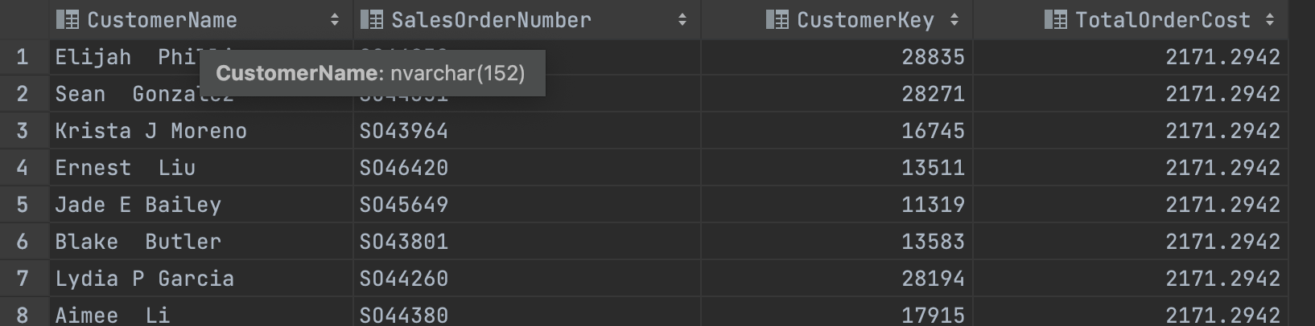
Inventory Exercise
9. Get information 20 Internet Sales invoices with the highest total payable including the following columns: CustomerName, SalesOrderNumber, CustomerKey, TotalOrderCost
Note: SalesOrderNumber has multiple SalesOrderLineNumber

Slide 34
9.ANSWER
SELECT
MAX( c.FirstName + CONCAT(FirstName,' ', MiddleName ,' ',LastName)) as CustomerName,
s.SalesOrderNumber,
MAX(s.CustomerKey) as CustomerKey,
Sum(s.TotalProductCost ) AS TotalOrderCost
FROM
FactInternetSales s
JOIN
DimCustomer c ON s.CustomerKey = c.CustomerKey
group by SalesOrderNumber
ORDER BY Sum(s.TotalProductCost ) DESC;

Slide 35
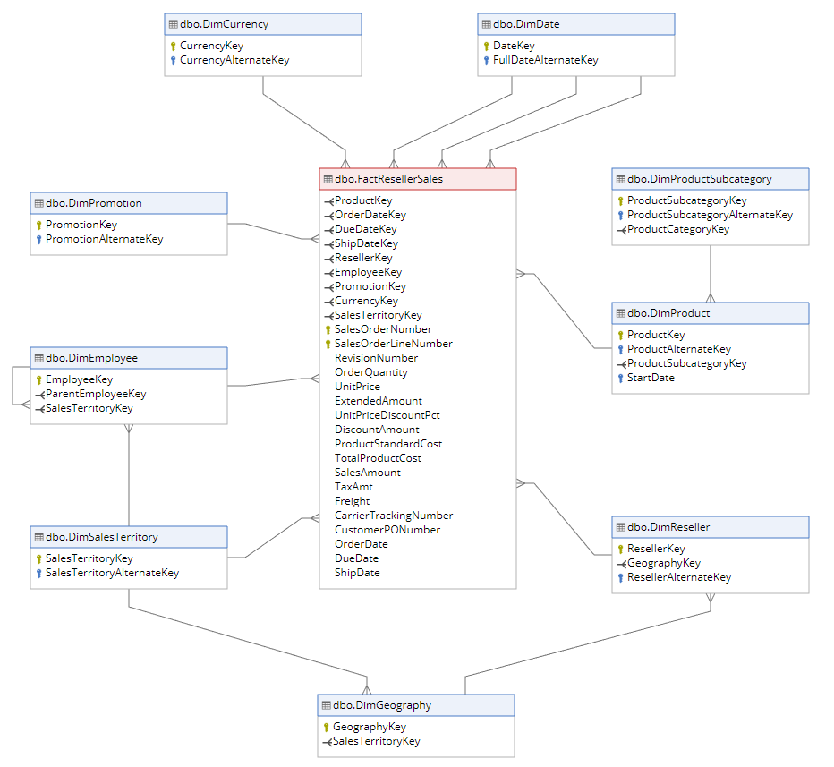
Reseller Sales
Reseller Sales

Slide 36
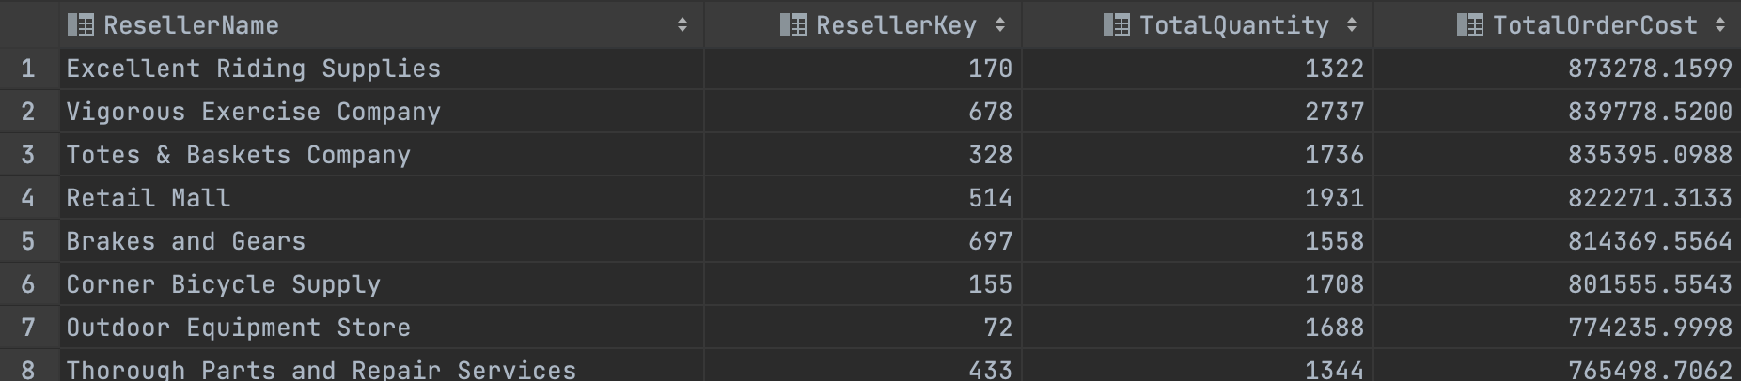
Reseller Sales Exercise
10. Get the top 10 resellers with the highest revenue including the following schools:
ResellerName, ResellerKey, TotalQuantity, TotalOrderCost

Slide 37
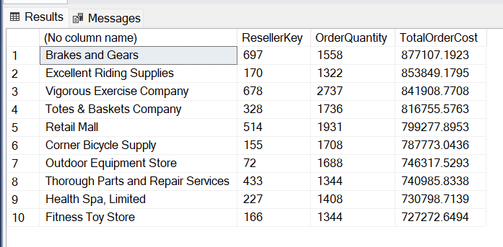
10.ANSWER
SELECT top 10
MAX( r.ResellerName) ,
s.ResellerKey,
Sum(s.OrderQuantity) OrderQuantity,
Sum(s.SalesAmount) AS TotalOrderCost
FROM
FactResellerSales s
Join
DimReseller r ON r.ResellerKey= s.ResellerKey
group by s.ResellerKey
ORDER BY Sum(s.SalesAmount) DESC;

Slide 38
04. Optimize

Slide 39
1. Subquery vs Join
A join is a query that combines records from two or more tables. A join will be performed whenever multiple tables appear in the FROM clause of the query.
A Subquery or Inner query or Nested query is a query within SQL query and embedded within the WHERE clause. A Subquery is a SELECT statement that is embedded in a clause of another SQL statement.
There is no generic answer. It depends on the platform, the purpose you are using. A subquery is easier to write, but a joint might be better optimized by the server. For example a Left Outer join typically works faster because servers optimize it.

Slide 40
2. Performance with Join
Nested loop join (with & without ORM)
Hash join
The algorithm of Hash Join is to build a hash table for the right table. Then, traverse the left table and probe the hash table based on the hash value of the join key. Therefore, the right table is called the build side, and the left table is called the probe side.
Merge join (Sort-merge join)
It sorts the left and right tables and then merges the two sorted tables according to the K-way merging algorithm. The time complexity of sorting is O(nlog(n)), and the merging time complexity is O(n). The overall time complexity is O(nlog(n)).
EXISTS vs IN vs JOINs

Slide 41
























ICONS

Slide 42
























ICONS

Slide 43
























ICONS

